Slide 1
The Eclipse BIRT Project
- An Open Source Reporting Alternative
Paul Clenahan
BIRT Project Management Committee (PMC)
VP of Product Management, Actuate

Slide 2













What Is Eclipse?
Eclipse is an open source community focused on developing a universal platform of frameworks and exemplary tools that make it easy and cost-effective to build and deploy software in today’s connected and unconnected world.
Eclipse is a consortium of 13 Strategic Members, 64 Add-in Providers and 14 Associate Members (Publishers, Research Institutes, Standards Org., etc.).

Slide 3
Momentum Around the Eclipse IDE
39 million+ download request since the project initiated.
“Within the tools market, the options have narrowed to two front-line players: MS Visual Studio family, and the Eclipse based technologies…”
      SD Times, August 1, 2004
Eclipse
Emacs/VI/Text pad
WebSphere AD
JBuilder Enterprise
NetBeans
VisualStudio.Net
JBuilder Free / Basic
IntelliJ IDEA
Oracle JDeveloper
WebLogic Workshop
Together Soft
Sun ONE Studio
Rational XDE
Rational Rapid Developer
OptimalJ
Other
0%
10%
20%
30%
40%
50%
60%

Slide 4

Business Intelligence and Reporting Tools
Actuate joins Eclipse as Strategic Developer and proposes BIRT
Initiative is part of the Eclipse Open Source community
Focused on embedded reporting needs for J2EE
Addresses a key J2EE application development pain-point

Slide 5
BIRT Top-Level Project Scope
BIRT Initial
Focus
Operational Reporting
Ad hoc Query & Reporting
Analytics/OLAP/Data Mining
In Reality, this is a Continuum:
Typical Characteristics:
Operational reports
Developer creates reports
Very easy end user access
Highly formatted
Multiple output formats
No end user training needed
Data access can be complex
Simple ad hoc exploration of data
Business user creates reports
Fairly easy to use
Typically limited formatting
Interactive
Minimal training
Semantic layer hides complexity
Complex “Slice and Dice” of data
Business user creates reports
More complex to use
Minimal formatting
Very interactive
Requires training
Semantic layer/data cubes

Slide 6
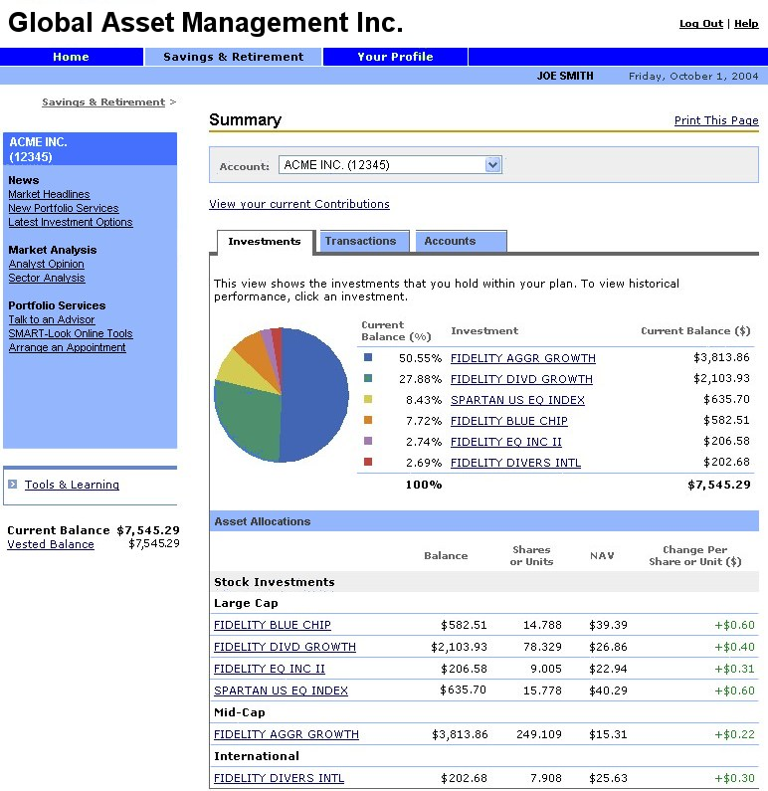
Example: Financial Web Site
Site Navigation
Print Report
News & Promotions
Investment Report

Slide 7
What are the Project Components?
Initially focused on embedded reporting for Java developers
Proposal has 4 initial projects
Eclipse
Report
Designer
Web Based
Report
Designer
Custom
Report
Designer…
Report Engine
Custom
Services…
Data Transform.
Services
Charting
Services
1
4
3
HTML
PDF
Print
XML
…
2
Report Design Engine
Generation
Services
Presentation
Services
XML
Report
Design
Data
Report
Document

Slide 8
Extensible Tools and Frameworks
Extensibility is a key principle for the BIRT project
  Enables unpredicted usage scenarios
Data source extensibility
  Application specific design-time query builders
  Custom design and run-time data access
Data manipulation extensibility
  Incorporate complex business logic scripting
  Access existing and new Java code
Visualization extensibility
  Build new visual data presentation ‘widgets’
  Extend charting with new chart types; new output formats
Rendering reports for output
  Target report output for specific devices

Slide 9
BIRT Initial Target Users
Java developer
  Designs reports using Eclipse-based designer
  Embed pre-designed reports in application
  Provide “guided” report design capabilities in application
    Highly parameterized reports
    Customized, rich parameterization user interface
  Application specific report creation user interface
Business User
  Uses report facilities provided by developer

Slide 10
Code Contributions and Collaboration
Ground-up initiative targeting Java developer needs
Actuate R&D project in this area since Q1, 2004
  Actuate has donated all work from this project
Project aims to leverage other open source
  Example: Mozilla Rhino (JavaScript engine)
Active collaboration with other Eclipse projects

Slide 11
Business Intelligence & Reporting Tools Timeline
BIRT Project Proposal posted on August 24, 2004
BIRT Project accepted on September 30, 2004
Nov, 2004 | Published Release 1.0 Goals/Requirements
Dec, 2004 | Released Draft XML Report Design Schema documents to community Eclipse infrastructure for BIRT up and running Initial code release for Report Object Model component
Jan – Feb, 2005 | Incremental code releases: Execution Engine, Eclipse Report Designer, Data Access components, Chart Engine
Feb, 2005 | 1.0 Preview Release: Eclipse Report Designer, Report Engine, Chart Engine
Mar – May, 2005 | Community feedback Incremental milestone builds with additional features and responding to feedback
May 2005 | 1.0 Release Target Date: Eclipse Report Designer, Report Engine, Chart Engine
Q4 2005 | Release 2.0

Slide 12
BIRT Release 1.0 Components
Report Designer plug-in for Eclipse framework
  Graphical WYSIWYG report layout design tool
  SQL Query editor
  General support for common reports
  Ability to run and preview reports
  Output from tool is XML report design
Java Report Engine for deployment
  Java class libraries for generating reports from design
  Designed to be embedded into Java applications
  Report output is HTML, PDF
Business Chart component
  Java class libraries for generating SWT, Swing and PNG charts
  Designed to be embedded into Java applications and reports

Slide 13
BIRT Advantages for the MySQL Community
To Java Developers
  Open Source reporting alternative for MySQL
  Fully integrated into the Eclipse environment
  Saves calories vs. JSP/Java for reports from MySQL
  Minutes vs. days for HTML, vs. weeks for PDF
  Minutes to modify as user requirements change
To Application End-Users
  Nice looking reports from MySQL databases
  Content as HTML and PDF
To Application Owners
  Minimizes Eclipse developer training
  Iterative development gets the right reports quicker

Slide 14
Using BIRT with MySQL
BIRT 1.0 includes support for JDBC and can easily access MySQL
Download and install Eclipse components and BIRT
  Instructions at: http://www.eclipse.org/birt
Download and unzip MySQL Connector/J 3.1 JDBC driver
  Located at: http://dev.mysql.com/downloads/
Configure BIRT to use the MySQL Connector/J 3.1 driver…

Slide 15

Configuring BIRT to Access MySQL
Easy configuration where BIRT automatically registers the JDBC driver
JDBC JAR files must be copied to specific locations
BIRT will include a user interface to do this configuration step
How To:
1. Create eclipse\plugins\org.eclipse.birt.report.data.oda.jdbc_0.0.1\drivers
Place the MySQL JDBC JAR file in this directory
For runtime, repeat same steps for:
eclipse\plugins\org.eclipse.birt.report.viewer_0.0.1\birt-viewer\WEB-INF\plugins\org.eclipse.birt.report.data.oda.jdbc\
This How To applies to BIRT 1.0M3 builds and later. For BIRT 1.0M2 see appendix.

Slide 16
Configuring BIRT to Access MySQL: UI Hints
Customize the BIRT user interface to make MySQL even easier to access!
Make it easy for a wider audience to write reports on your MySQL database
  You could even include hints for your specific MySQL database configuration
How To:
Edit eclipse\plugins\org.eclipse.birt.report.data.oda.jdbc_0.0.1\plugin.xml. Insert bold:
For runtime, repeat same edit for plugin.xml in:
eclipse\plugins\org.eclipse.birt.report.viewer_0.0.1\birt-viewer\WEB-INF\plugins\org.eclipse.birt.report.data.oda.jdbc\
…
<extension point="org.eclipse.birt.report.data.oda.jdbc.driverinfo">
…
<jdbcDriver
driverClass=“com.mysql.jdbc.Driver"
urlTemplate="jdbc:mysql://[host][,failoverhost...][:port]/[database]…"
name="MySQL Connector/J 3.1">
</jdbcDriver>
</extension>
…
This How To applies to BIRT 1.0M3 builds and later. For BIRT 1.0M2 see appendix.

Slide 17

BIRT in Action!

Slide 18
Ways to Get Engaged in BIRT
As a user of BIRT technology
  Testing BIRT and providing feedback in the process of using it
As an active member of the BIRT community
  Developing tutorials, examples, etc.
  Active in the BIRT newsgroup
As a developer of extensions
  Extending BIRT through the standard extension points
    Data sources; new charts; new output formats; …
  Could be for the open source community, could be for internal use
As a developer in existing BIRT code
  Need to get engaged through the Eclipse development model
Proposing/leading a new project under the BIRT umbrella

Slide 19
The BIRT Community
Project Committers
  Actuate (http://www.actuate.com)
  Innovent Solutions (http://www.innoventsolutions.com)
BIRT pages on Eclipse web site are up and running
  http://www.eclipse.org/birt
  Download BIRT and walk through a tutorial
Provide feedback and comments via newsgroup
  news://news.eclipse.org/eclipse.birt
Participate through the Eclipse development process
  See http://www.eclipse.org > Projects
Contact Project Management Committee (PMC)
  Paul Clenahan
  pclenahan at actuate.com
  (650) 837 2220

Slide 20
Appendix: Configuring BIRT builds earlier than 4/7/2005 to access MySQL

Slide 21
Configuring BIRT to Access MySQL: 1.0M2
Applies to BIRT 1.0M2 build and earlier
How To:
Edit eclipse\plugins\org.eclipse.birt.report.data.oda.jdbc_0.0.1\odaconfig.xml. Insert bold:
Copy the MySQL JDBC JAR into the same folder as odaconfig.xml
Repeat steps 1 and 2 for folder:
eclipse\plugins\org.eclipse.birt.report.viewer_0.0.1\birt-viewer\WEB-INF\plugins\drivers\jdbc\
…
<DriverLibraries>
<LibrariesForOS>
…
<LibraryName>mysql-connector-java-3.1.7-bin.jar</LibraryName> …
</LibrariesForOS>
…
This How To applies to BIRT 1.0M2 and earlier.

